Slide 1
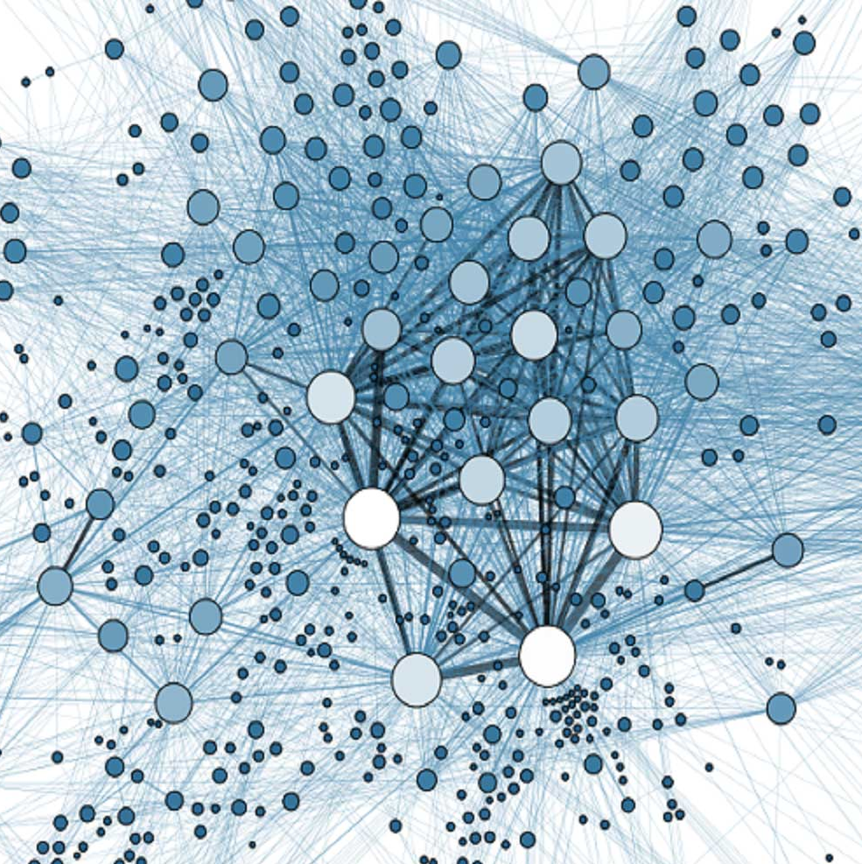
Social Network Analysis for
Heterodox Inquiry
Bruce Cronin
18102018

Slide 2
Agenda
Introduction to social network analysis
Data considerations
Economic applications
Some network metrics
Socio-economic (heterodox) applications
Reflection

Slide 3
MSCo - Formal Organisation
Barry
CEO
Corporate
Kim
John, David, Gwenda,
Hilary, Dave
Product 1
Joan
Fred, Manuel,
Nick, Simon, Will, Tamison,
Dwain, Eric, Erica, Alfred,
Becky, George, Sue, Eve,
Ian, Elizabeth, Rob
Product 2
Chris
Albert, James, Mike,
Ron, Peter, Paul,
Thomas, Tom, Martin,
Sam, Timothy, Carol,
Claire, Lucy, Susan,
Wendy, Angela, Ian,
Gary, Nicholas, Pat,
Maureen, Tony

Slide 4
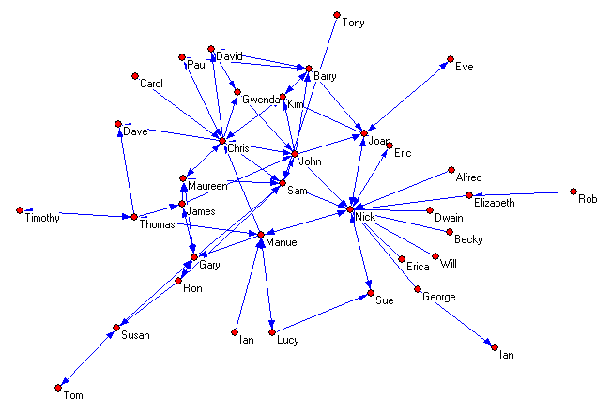
MSCo – Informal Network
From whom do you obtain information important to do your work?

Slide 5
Social Network Analysis
A set of techniques for identifying and representing patterns of interaction among social entities (node, vertex)
Provides precise and specific insight in place of intuition and general hunches
Graphical:
Directional relationship
  e.g. ‘Provides advice to’ (arc)
Non-directional relationship
  e.g. ‘Shares an office with’ (edge)
Strength of Relationship
  e.g. Frequency of contact
  e.g. Value or importance to the participants

Slide 6
Some Terminology
Arc
Vertex
Edge
Line/Tie
Node

Slide 7
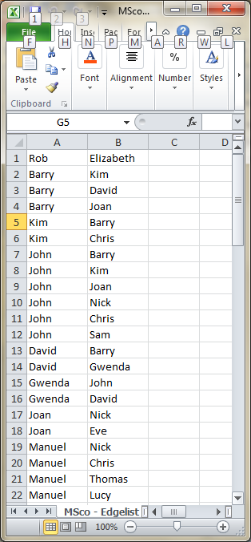
Where do the Lines Come From?
Opinion survey
  Personal interview.
  Questionnaire.
  Web-questionnaire.
Observation
  Email scanning (eg. Tacit, Morphix)
  Social media logs (FB, LI, Twitter)
  Open Data Archive APIs.
  Placement.
  Management reflection.
  Experiment.

Slide 8
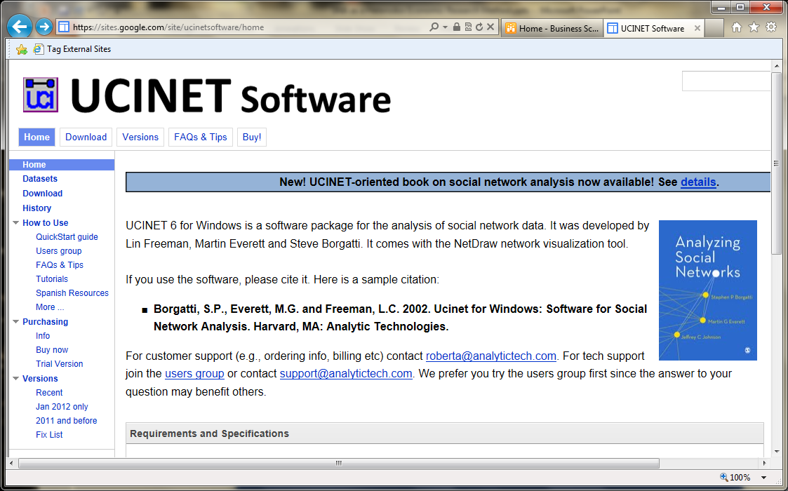
https://sites.google.com/site/ucinetsoftware
Developed by
Martin Everett (University of Greenwich)
Steve Borgatti (Boston College)
Lin Freeman (UC Irvine)

Slide 9
SNA Freeware
Netdraw https://sites.google.com/site/netdrawsoftware/download
Pajek http://vlado.fmf.uni-lj.si/pub/networks/pajek
ORA http://www.casos.cs.cmu.edu/projects/ora
Gephi https://gephi.org/
Visone https://visone.ethz.ch/
R-sna http://cran.r-project.org/web/packages/sna
NetworkX (python) https://networkx.github.io/

Slide 10
Activity
Download Netdraw
Open Padgett

Slide 11
Data Collection for SNA
Considerations
  Highly sensitive to response rate. Emerging statistical techniques.
  Roster - Assess respondent’s relationship with each member of organisation listed.
  Vulnerable to subjective interpretation
    what is a friend?
    prompt specific time periods
  Problems of recall
  Personal sensitivity

Slide 12
Example Questions
Who do you most often discuss personal matters with?
Who do you most often spend free time with?
Who do you report to?
Who is your most promising subordinate?
Who are your most valued contacts in the firm?
Who is an essential source of buy in?
Who is the contact most important to your continued success in the firm?
Who is your most difficult contact?
With whom would you discuss moving to a new job?
Who do you go to so that you can say ‘I ran it by …. and they said …’?
With whom do you discuss issues important to your work?
Cross et al. (2001), Burt (2001)

Slide 13
Ethical Considerations
Respondent anonymity is not possible because specific personal relationships are the object of study
  ‘Tom – Alice’ not ‘X - Y’
Respondents may cite relationships with third parties who may not wish to participate in the study
  while respondents are reporting their own perception, they are also reporting shared information – the fact that a relationship exists

Slide 14
Ethical Considerations
Confidentiality is difficult as participants may deduce the identity of individuals from a network position, even when presented anonymously in a sociogram
Informed consent is difficult to obtain because the technique is new and participants probably will not fully anticipate the implications of the information they provide

Slide 15
Boundary Definition
Participants have different conceptions of group boundaries
  e.g. ‘close’ associates
Geographic or organisational boundaries may overlook important social relationships.
  e.g. money flows strongly influenced by government agencies and banks
Cut-off points often arbitrary
  e.g. 100 largest companies
Boundary definition based on theoretical significance
Completeness important
  10% sample = 90% connections missed
  Radically affects network structure
Laumann, Marsden & Prensky (1983)

Slide 16
Sampling Strategies
Positional approach
  Occupants of formally defined positions or groups
  Problem – boundary definition
Reputational approach
  Expert panel - knowledgeable informants
  Snowballing – a few nominate others, who nominate others
  Problem - Likely to be well-connected by definition
Event approach
  Identify those who participate in significant events
  Problem – event selection, extent of participation
Laumann, Marsden & Prensky (1983)

Slide 17
Applications

Slide 18
MSCo – Informal Network
From whom do you obtain information important to do your work?

Slide 19
Make a case for this KM expenditure
Cross-group projects
Mixed-revenue goals
Weekly status calls
Weekly email updates
Project tracking database
Adapted from Cross, R and Parker, A., The Hidden Power of Social Networks, Harvard Business School Press, 2004

Slide 20
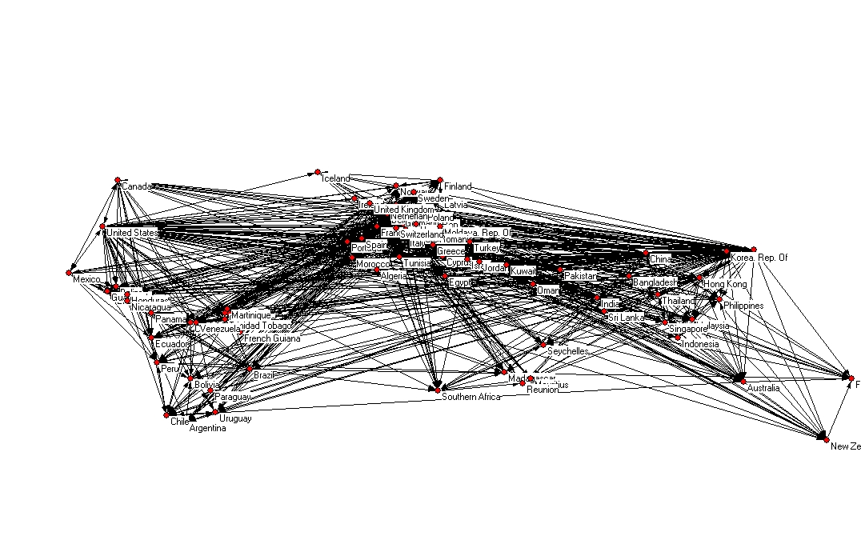
World imports - potatoes

Slide 21
Inter-organisational Networks
Supplier
Manufacturer
Distributor
Retailer
Supplier
Manufacturer
Distributor
Retailer
Adapted from Porter (1985)

Slide 22
Alliance Structure of the Global Information Sector
1
BT
TI
ATT
MOTOROLA
BCE
AOL
ERICSSON
PHILIPS
0
MATSUSHITA
MICROSOFT
CISCO
NOVELL
SUN
NTT
IBM
SONY
TOSHIBA
HP
HITACHI
INTEL
ORACLE
FUJITSU
COMPAQ
APPLE
MITSUBISHI
NEC
SAMSUNG
SIEMENS
-1
-1
0
1
1.5
Knoke, Yang & Granados 2002. ‘Dynamics of Strategic Alliance Networks in the Global Information Sector, 1989-2000

Slide 23
Some network metrics

Slide 24
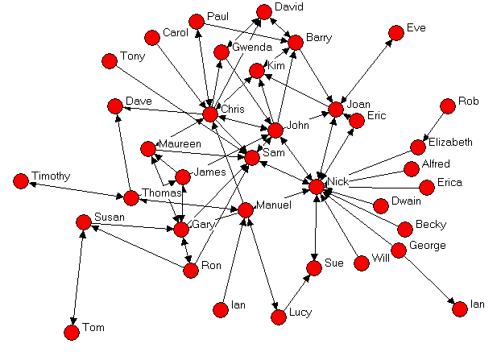
Centrality
Who is the most important person in this network?

Slide 25
Social Capital and Network Position
Configuration of social relationships provides leverage for political or economic activity.
Social Capital from Cohesiveness
Centrality
Social Capital from Brokerage
Betweenness

Slide 26
Activity
Examine the Msco Edgelist.xlsx file
In Netdraw, load Msco Edgelist
Calculate centrality metrics
Visualise different centrality metrics

Slide 27
Activity
Examine the Msco Attributes.xlsx file
In Netdraw, with Msco Edgelist loaded, load Msco Attributes
Calculate centrality metrics
Visualise different centrality metrics

Slide 28
Brokerage Roles
B
B
gatekeeper
coordinator
C
C
A
A
B
B
Itinerant broker
C
liaison
A
C
A
B
representative
C
A
B’s position varies according to the relationship between a and c

Slide 29
Cliques
A sub-set of points where all possible pairs of points are directly connected (maximal and complete).
3 member clique
4 member clique
5 member clique
Strong cliques – reciprocated connections
Weak cliques – undirected or unreciprocated connections
Scott (1991), Doreian (1979)

Slide 30
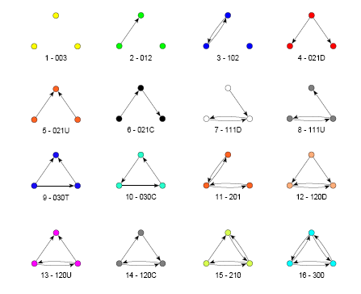
Triadic census

Slide 31
Getting a Job
Granovetter’s (1974) doctoral study under Harrison White, Harvard
Job search not a rational calculation of rewards and costs
56% respondents found jobs through informal personal contacts
Most important contacts were ‘weak ties’; job change more likely where respondents had more non-family contacts in different occupations. i.e. access to different information.
c.f. ‘strong ties’; more likely to hold the same information.
Typically one intermediary between employer and respondent; i.e. short weak chains.

Slide 32
Creativity
Large Massachusetts electronics firm attempting to retain creativity after a series of acquisitions.
  673 supply chain managers asked to write ideas on how to improve business processes.
  Ideas ranked by senior execs
  Social network of managers analysed (“who do you most often discuss supply chain issues with”)
  Highest ranked ideas came from
  managers with largest no. of contacts
  outside their immediate work group.
R. Burt, 2004 “Structural Holes and Good Ideas" American Journal of Sociology, 110(2), 349-399.

Slide 33
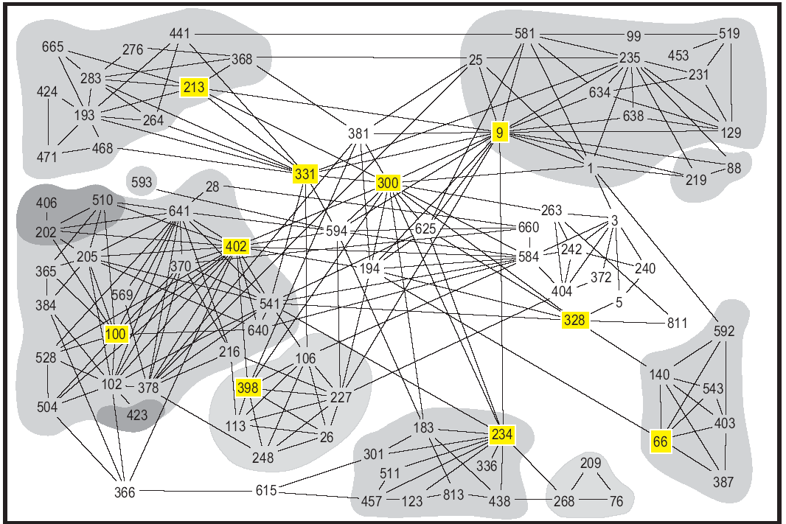
Creativity
R. Burt, 2004 “Structural Holes and Good Ideas" American Journal of Sociology, 110(2), 349-399.

Slide 34
Heterodox applications

Slide 35
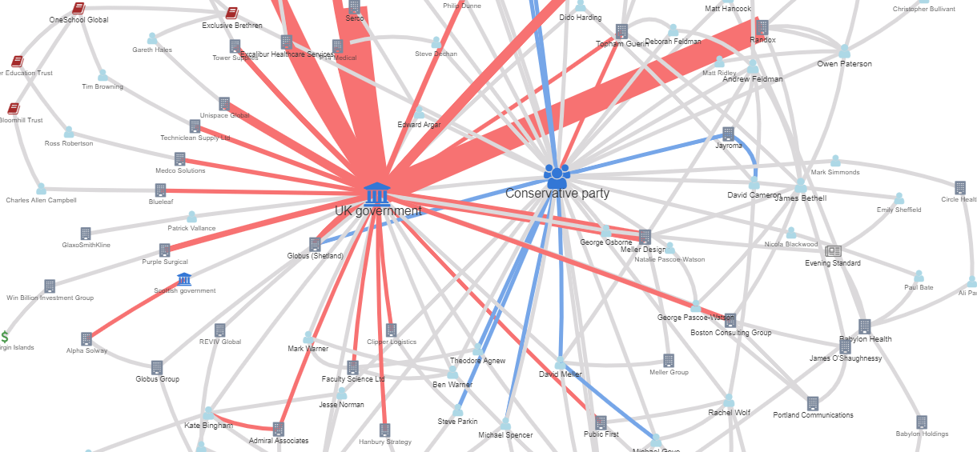
My little crony
https://sophieehill.shinyapps.io/my-little-crony/

Slide 36
Ministerial Meetings

Slide 37
Meetings with Ministers pay
 | EBITDA marg | PE Ratio | EV/ EBITDA | CF/OR | ROA Net | Marcap / CF | ROE Net | ROCE Net | EBIT marg | ROCE Gross | Profit Marg | ROA Gross | ROE Gross
Δ 2010-12 | 0% | 14% | 19% | 26% | 41% | 83% | 820% | 21% | 23% | 32% | 194% | 264% | 540%
Ln Assets | +
Interlock C |  |  |  | - |  |  |  | - | - | -
Interlock E |  |  |  |  | + | - |  | + |  |  |  |  | +
Interlock B |  | + |  | - |  |  |  |  |  |  |  | +
Meet C |  |  | + | +
Meet E | + |  | + |  |  |  |  |  | + |  |  |  | +
Meet B |  | +
Obs. | 17292 | 2256 | 3080 | 3080 | 4290 | 2162 | 4032 | 3540 | 3906 | 3660 | 4830 | 4422 | 4422
Adj. R² | 0.154 | 0.192 | 0.151 | 0.197 | 0.248 | -0.228 | 0.119 | 0.397 | 0.514 | 0.388 | 0.495 | 0.501 | 0.484

Slide 38
Evolution of UK Managerial Careers

Slide 39
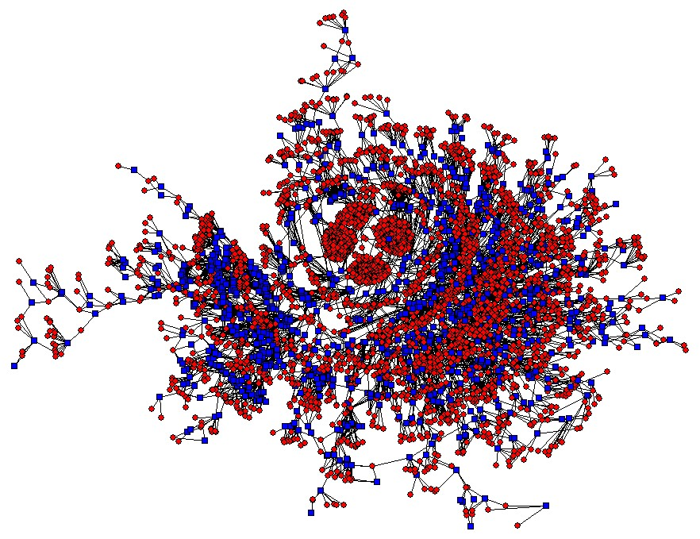
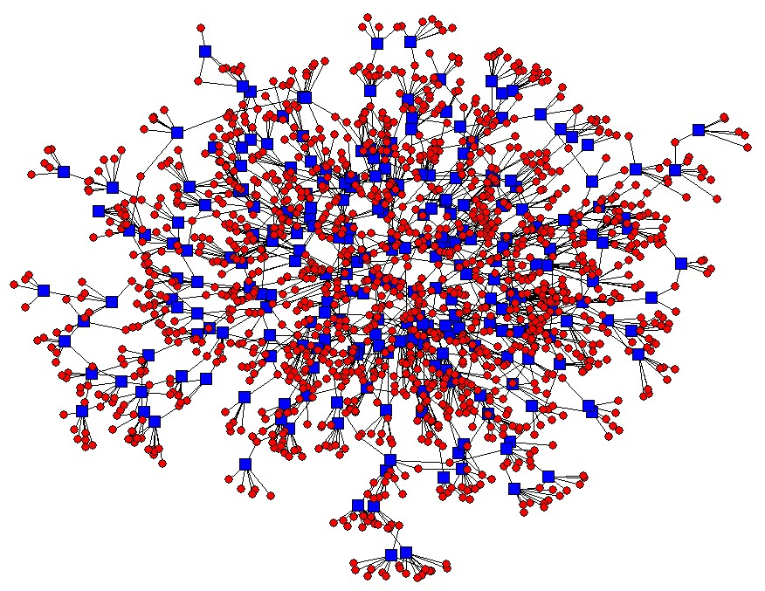
Fragmentation of UK Director Interlocks
2006
2009
> £500m

Slide 40
11-core of the 2008 RAE publication network

Slide 41
Heterodox
Economic
Journals

Slide 42
Journal Network Quality Score
(JNQS) = [EC] + [BC] + ([C] + [I] + [G])/3 + ([R] + [L])/2
(EC) concentrations of specialised knowledge within a discipline
(BC) demonstrates integration
(C) coordinator (I) itinerant broker and (G) gatekeeper roles internally oriented
(R) representative and (L) liaison roles externally oriented

Slide 43
Heterodox
Economic
Journal
Rankings
Journal Name | Type of Journal | Bibliometric Ranking | Social Network Ranking | Total Citation Ranking | Peer Evaluation Ranking | Final Ranking – HJQS (Z Score)
Cambridge Journal of Economics | General | 24 | 2 | 5 | 1 | 1 0.5419 (3.43)
Journal of Economic Issues | General | 5 | 19 | 6 | 3 | 2 0.4412 (2.32)
Journal of Post Keynesian Economics | General | 18 | 30 | 23 | 2 | 3 0.3931 (1.79)
Review of Radical Political Economics | General | 14 | 15 | 8 | 4 | 4 0.3802 (1.65)
Economy and Society | Interdisciplinary | 9 | 7 | 4 | 13 | 5 0.3521 (1.34)
Lee, F., Cronin, B., McConnell, S. and Dean, E. (2010). Research quality rankings of heterodox economic journals in a contested discipline. American Journal of Economics and Sociology, 69(5), 1409-52.

Slide 44
Reflection
What are the main pros and cons of social network analysis (SNA) as a method?
In what ways does SNA reflect the ontological concerns discussed elsewhere in the workshop?
How might you use SNA in your own work?

Slide 45
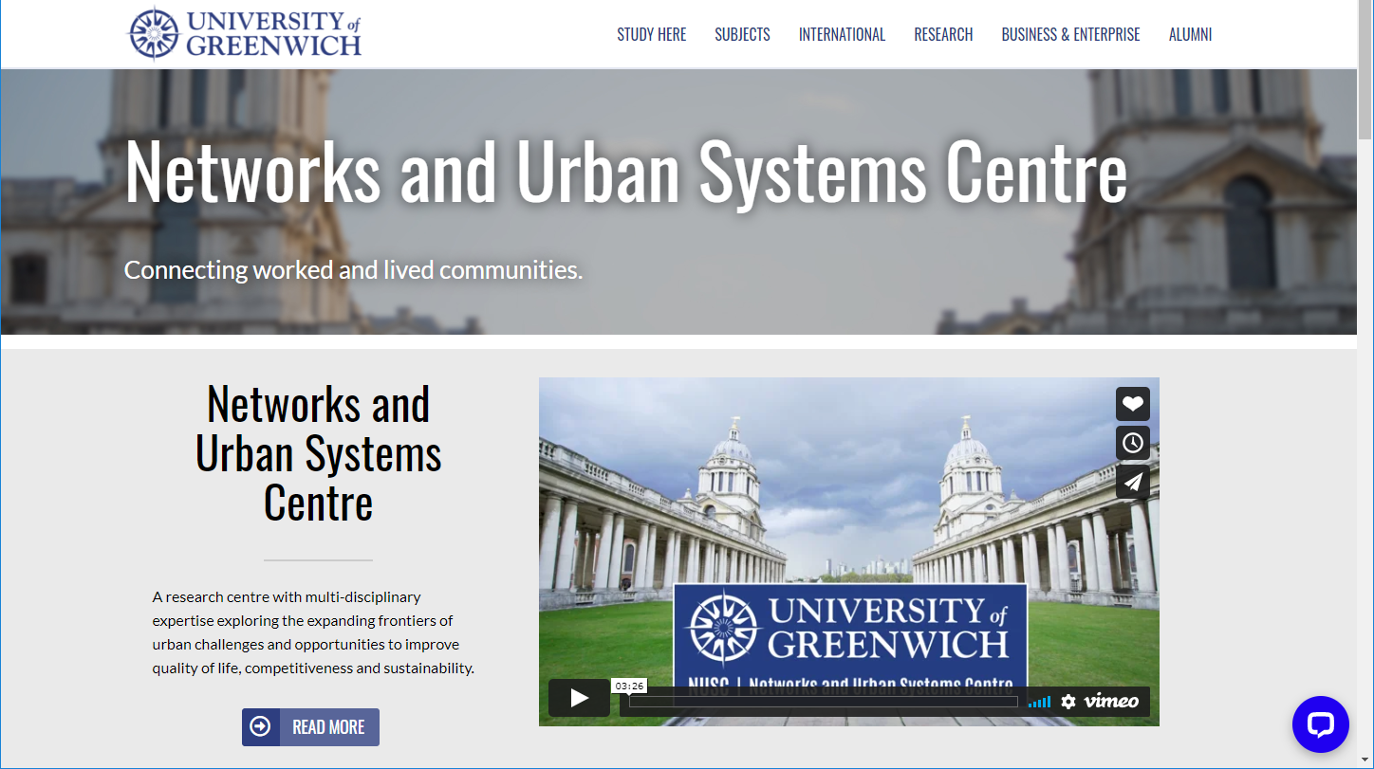

Slide 46
Sign off page

